Slide 1
Chapter 3
How to use HTML to structure a web page

Slide 2
Objectives
Applied
Code a properly structured HTML web page using the HTML5 semantic elements and any of the other elements that are presented in this chapter.
Code a relative URL that refers to any file in the folder structure of the website.
Knowledge
Describe the use of the title and meta elements in the head section of an HTML document.
Distinguish between a block element and an inline element.
Describe the use of these block elements: h1, h2, h3, p, and div.
Describe the use of these inline elements: br, em, strong, and span.
Describe the use of character entities like &nbsp; or &copy;.

Slide 3
Objectives (continued)
Describe the use of these core attributes: id, class, and title.
Describe the use of the div and span elements in the HTML for a modern website.
Describe the use of these HTML5 semantic elements: header, main, footer, section, article, nav, aside, and figure.
Distinguish between absolute and relative URLs, and distinguish between root-relative and document-relative paths.
Distinguish between the use of the <a> element and the <img> element.
Describe the accessibility guidelines for <a> elements and <img> elements.
Describe the three types of lists that you can create with HTML.

Slide 4
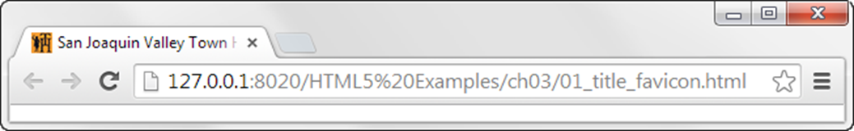
A browser that shows the title and favicon
A head section with a title and a link to a favicon
<head>
<title>San Joaquin Valley Town Hall | speakers and luncheons
</title>
<link rel="shortcut icon" href="favicon.ico">
</head>

Slide 5
A head section that includes metadata
<head>
<title>San Joaquin Valley Town Hall | speakers and luncheons
</title>
<meta charset="utf-8">
<meta name="description" content="A yearly lecture series with speakers that present new information on a wide range of subjects">
<meta name="keywords" content="san joaquin, town hall, speakers, lectures, luncheons">
</head>

Slide 6
SEO guidelines for the title tag
Always include a title tag in the head section.
The title should accurately describe the page’s content.
The title should include the one or two focus keywords that you want to be used for ranking the page.
The title should be interesting enough to entice the reader to click on it when it’s shown in the search results for a search engine.
The title should be unique for each page in your website.
Limit the length of your titles to around 65 characters because most search engines don’t display more than that in their results.

Slide 7
SEO guidelines for the meta tags
Include the description metadata for each page of your website.
The description should summarize the contents of the page, it should be unique for each page, and it can be longer than the title tag.
When the description is displayed in the search-engine results, it should encourage users to click on your link.
Include the keywords metadata for each page of your website.
You should use no more than 10 keywords or phrases in the metadata, and the metadata should be unique for each page.

Slide 8
HTML that uses h1, h2, and <p> block elements
<h1>San Joaquin Valley Town Hall Programs</h1>
<h2>Pre-lecture coffee at the Saroyan</h2>
<p>Join us for a complimentary coffee hour, 9:15 to 10:15
a.m. on the day of each lecture. The speakers usually
attend this very special event.</p>
<h2>Post-lecture luncheon at the Saroyan</h2>
<p>Extend the excitement of Town Hall by purchasing
tickets to the luncheons</p>

Slide 9
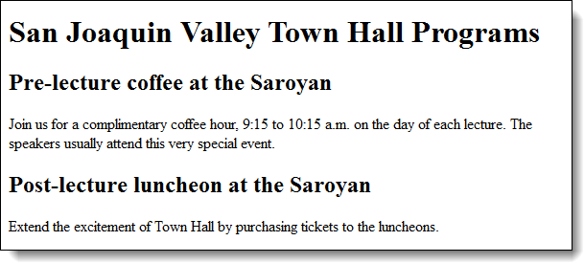
The h1, h2, and <p> elements in a web browser

Slide 10
SEO guidelines for heading tags
Use the heading tags to show the structure and importance of the content on a page.
Always use the h1 tag to identify the most important information on the page, and only code a single h1 tag on each page.
Then, decrease one level at a time to show subsequent levels of importance.
Don’t use heading levels as a way to size text. Instead, use CSS to size the headings.

Slide 11
HTML that uses block elements
<p>How to use JavaScript to display the year:</p>
<pre>
var today = new Date();
document.writeln( today.getFullYear() );
</pre>
<p>Ernest Hemingway wrote:</p>
<blockquote>
Cowardice, as distinguished from panic, is almost always simply a lack of ability to suspend the functioning of the imagination.
</blockquote>
<p>How to contact Mike Murach &amp; Associates:</p>
<address>
<div>1-800-221-5528</div>
<div><a href="emailto:murachbooks@murach.com"> murachbooks@murach.com</a></div>
</address>

Slide 12
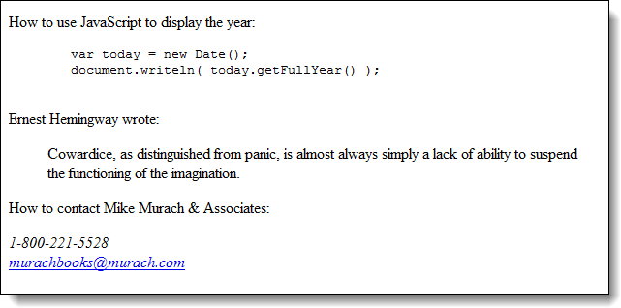
The block elements in a web browser

Slide 13
HTML that uses some of the inline elements
<p>If you don't get 78% or more on your final, <em>you won't pass.</em></p>
<p>Save a bundle at our <strong>big yearend sale</strong>.</p>
<p>When the dialog box is displayed, enter <kbd>brock21</kbd>.</p>
<p>The chemical symbol for water is H<sub>2</sub>O.</p>
<p><q>To sleep, perchance to dream-ay, there's the rub.</q></p>

Slide 14
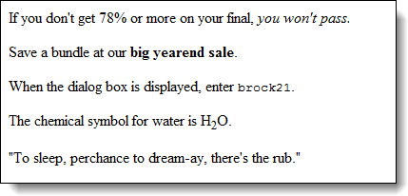
The inline elements in a web browser

Slide 15
Examples of character entities
<p>It&rsquo;s time to start your Christmas shopping!</p>
<p>President John F. Kennedy said, &ldquo;And so, my fellow Americans, ask not what your country can do for you; ask what you can do for your country.&rdquo;</p>
<p>&nbsp;&nbsp;&nbsp;&nbsp;Turning fear into hope, medical futurist Dr. Alan J. Russell will discuss the science of regenerating damaged or diseased human body parts, while offering real hope for the future of human health.</p>
<p>&copy; 2015 Mike Murach &amp; Associates, Inc.</p>

Slide 16
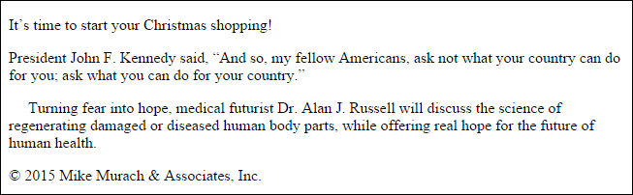
The character entities in a web browser

Slide 17
Code that uses the core HTML attributes
<html lang="en">
<body>
<h1>San Joaquin Valley Town Hall</h1>
<p class="first">Welcome to San Joaquin Valley Town Hall.</p>
<form action="subscribe.php" method="post">
<p>Please enter your e-mail address to subscribe to our newsletter.</p>
<p class="first field">E-Mail:
<input type="text" name="email"
id="email"
title="Enter e-mail here."></p>
<p><input type="submit" value="Subscribe"></p>
</form>
</body>
</html>
Accessibility and SEO guideline
Always code the lang attribute on the html element to identify the language for the page.

Slide 18
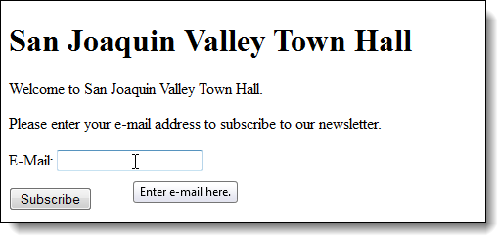
The HTML in a web browser with a tooltip

Slide 19
An HTML page structured with semantic elements
<body>
<header>
<h1>San Joaquin Valley Town Hall</h1>
</header>
<main>
<p>Welcome to San Joaquin Valley Town Hall. We have some fascinating speakers for you this season!</p>
</main>
<footer>
<p>&copy; Copyright 2015 San Joaquin Valley Town Hall.</p>
</footer>
</body>
Accessibility and SEO guideline
Use the HTML5 semantic elements to indicate the structure of your pages.

Slide 20
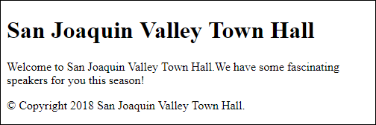
The page displayed in a web browser

Slide 21
The figure and figcaption elements
<figure>
<code>
var today = new Date();<br>
document.writeln( today.getFullYear() );<br><br>
</code>
<figcaption>
JavaScript code for getting the year
</figcaption>
</figure>

Slide 22
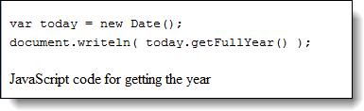
The fig and figcaption elements in a browser

Slide 23
A page structured with div and span elements
<body>
<div id="header">
<h1>San Joaquin Valley Town Hall</h1>
</div>
<div id="main">
<p><span id="welcome">Welcome to San Joaquin Valley Town Hall.</span> We have some fascinating speakers for you this season!</p>
</div>
<div id="footer">
<p>&copy; Copyright 2018 San Joaquin Valley Town Hall.</p>
</div>
</body>

Slide 24
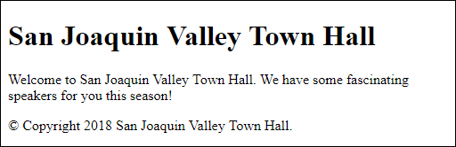
The div and span elements in a web browser
Accessibility and SEO guidelines for div and span elements
Use div tags only when the HTML5 semantic elements don’t apply.
Use span tags only when the tags for identifying content don’t apply.

Slide 25
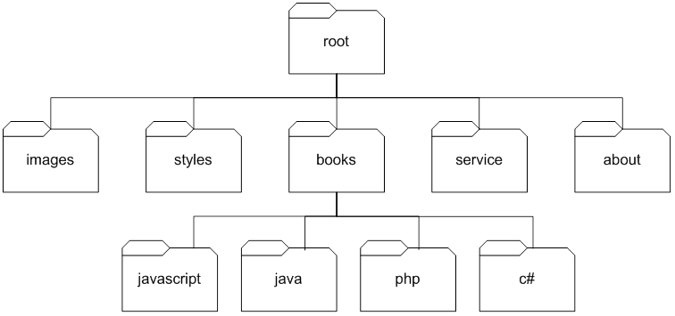
A simple website folder structure

Slide 26
Working with URLs and paths
Absolute URLs
http://www.murach.com/index.html
http://www.murach.com/books/php/toc.html
Root-relative paths
/login.html
/images/logo.gif
Document-relative paths that navigate down
images/logo.gif
books/php/overview.html
Document-relative paths that navigate up
../index.html
../images/logo.gif

Slide 27
Link examples
A link to a web page in the same folder
<p>Go view our <a href="products.html"> product list</a>.</p>
A link to a web page in a subfolder of the parent folder
<p>Read about the <a href="../company/services.html"> services we provide</a>.</p>
A link to a web page based on the root folder
<p>View your <a href="/orders/cart.html"> shopping cart</a>.</p>
A link to a web page at another website
<p>To learn more about JavaScript, visit the
<a href="http://www.javascript.com/"> official JavaScript web site</a>.</p>

Slide 28
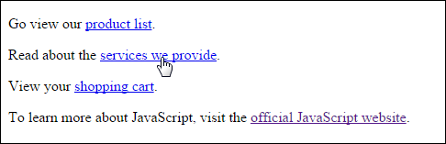
The link examples in a web browser
Accessibility and SEO guideline for links
The content of a link should be text that clearly indicates where the link is going.

Slide 29
HTML that creates two lists
<p>We have books on a variety of languages, including</p>
<ul>
<li>JavaScript</li>
<li>PHP</li>
<li>Java<li>
<li>C#</li>
</ul>
<p>You will need to complete the following steps:</p>
<ol>
<li>Enter your billing information.</li>
<li>Enter your shipping information.</li>
<li>Confirm your order.</li>
</ol>

Slide 30
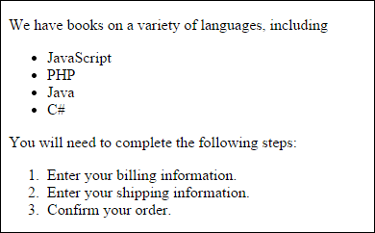
The lists in a web browser

Slide 31
HTML that creates a definition list
<p>Technologies learned:</p>
<dl>
<dt>HTML</dt>
<dd>Used to structure the web.</dd>
<dt>CSS</dt>
<dd>Used to style the web.</dd>
<dt>JavaScript<dt>
<dd>Used to implement interactivity on the web.</dd>
</dl>

Slide 32
An inline img element
<img src="images/murachlogo.gif" alt="Murach Logo" height="75">
<h1>Mike Murach &amp; Associates, Inc.</h1>

Slide 33

The image in a web browser

Slide 34

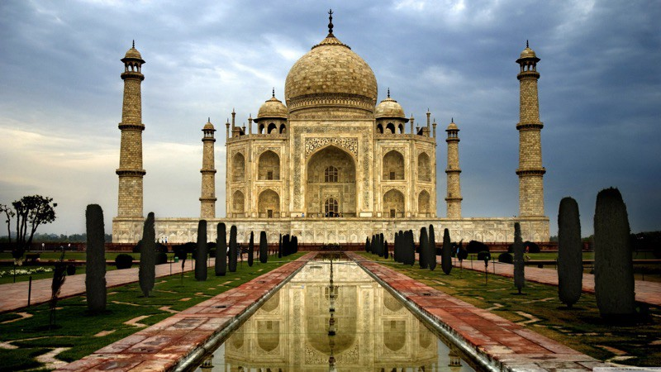
The image formats that are supported by most browsers
PNG
JPEG
GIF
Learn More: JPEG vs PNG vs GIF — which image format to use and when?
https://blog.imagekit.io/jpeg-vs-png-vs-gif-which-image-format-to-use-and-when-c8913ae3e01d

Slide 35
Accessibility guidelines for images
For images with useful content, always code an alt attribute that describes the image.
For images that are used for decoration, code the alt attribute with no value ("").

Slide 36
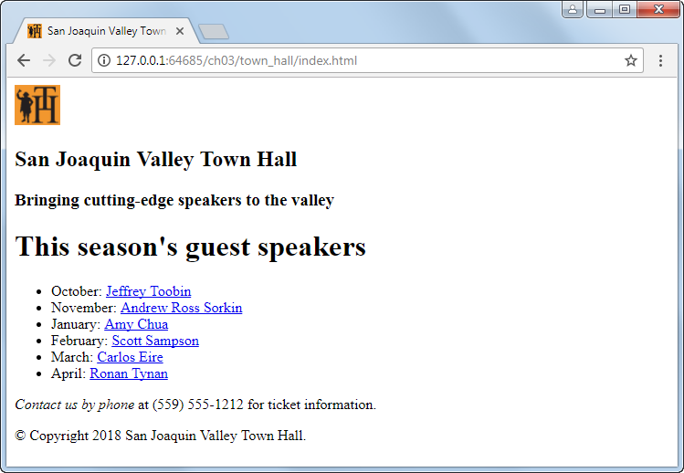
A simple web page

Slide 37
The HTML file for the simple web page
<!DOCTYPE html>
<html lang="en">
<head>
<meta charset="utf-8">
<title>San Joaquin Valley Town Hall</title>
<link rel="shortcut icon"
href="images/favicon.ico">
</head>
<body>
<header>
<img src="images/logo.jpg" alt="Town Hall Logo" width="50">
<h2>San Joaquin Valley Town Hall</h2>
<h3>Bringing cutting-edge speakers to the valley</h3>
</header>

Slide 38
The HTML file for the web page (continued)
<main>
<h1>This season's guest speakers</h1>
<nav>
<ul>
<li>October:
<a href="speakers/toobin.html">
Jeffrey Toobin</a></li>
...
...
</ul>
</nav>
<p><em>Contact us by phone</em> at (559) 555-1212 for ticket information.</p>
</main>
<footer>
<p>&copy; Copyright 2015 San Joaquin Valley Town Hall.</p>
</footer>
</body>
</html>

Slide 39
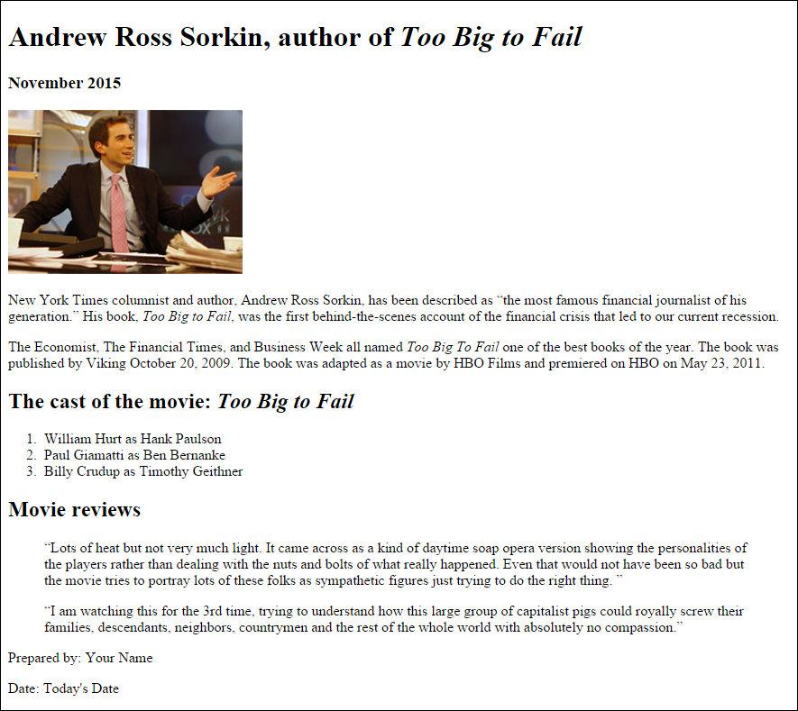
Short 3-1 Create an HTML page for a speaker

Slide 40
Objectives
Applied
Code a properly structured HTML web page using the HTML5 semantic elements and any of the other elements that are presented in this chapter.
Code a relative URL that refers to any file in the folder structure of the website.
Knowledge
Describe the use of the title and meta elements in the head section of an HTML document.
Distinguish between a block element and an inline element.
Describe the use of these block elements: h1, h2, h3, p, and div.
Describe the use of these inline elements: br, em, strong, and span.
Describe the use of character entities like &nbsp; or &copy;.

Slide 41
Objectives (continued)
Describe the use of these core attributes: id, class, and title.
Describe the use of the div and span elements in the HTML for a modern website.
Describe the use of these HTML5 semantic elements: header, main, footer, section, article, nav, aside, and figure.
Distinguish between absolute and relative URLs, and distinguish between root-relative and document-relative paths.
Distinguish between the use of the <a> element and the <img> element.
Describe the accessibility guidelines for <a> elements and <img> elements.
Describe the three types of lists that you can create with HTML.

Slide 42
Assignments
Reading assignments on Perusall
Homework and Labs on InsideRanken

